Slide 1
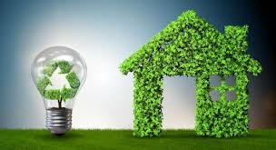
CRE is Proud to Introduce
Green Stemic
The Future of home building in America. And around the World

Slide 2
Introduction
CRE is proud to leverage their rich history of technologically superior engineering, by creating the most environmentally sustainable housing available in the market today.
Our Mission:
In every action we take, in every home we build, we focus on reducing our carbon footprint, by recycling, employing cutting edge technology and engineering, to create affordable, sustainable and safe homes.
Our Values:
Be effective stewards of our environment
Produce affordable homes for the average family
Provide meaningful employment, training and a path to prosperity
Be thought leaders through our actions, products and conduct

Slide 3
It is all in our Name Green Stemic
Green – To utilize every technology currently available to reduce our impact on the earth. While providing the highest quality of life.
Stemic
S = Sustainable – Using products with low carbon footprints, original or remanufactured.
T = Technology – Using the most current technology, Low voltage, hempcrete, ventless AC.
E = Energy and Efficiency – Thermal envelopes, water repurposing, Graphene Solar
M = Mobil – The ability to move, when where and why you need to move your asset.
I = Impactful – High impact on your life, low impact of the environment.
C = Customizable - Designs that are only limited to your Imagination.

Slide 4
Environmentally Sensitive Building
25-30% of carbon emissions in America are the result of heating and cooling American homes and businesses.
The opportunity to construct homes that are carbon neutral, due to the design of the thermal envelope, the use of solar collection, the reduction of energy waste via appliances is a reality in today’s world.
It is not only a good thing to do, but also the right thing to do for our climate.
Recycling and repurposing materials to construct energy efficient homes is doable with the technology that exist today.
By constructing homes in a facility as we purpose reduces the carbon footprint of the building before it is lived in.

Slide 5
Why Florida, Why Modular, Why Now?
1. New Home Construction estimated to be 1.4 million units this year.
Florida has 1000 people a day moving to the State, for the weather, lifestyle and low taxes.
2. Why Modular Due to the fact that 10,000 people per day are retiring, they are downsizing their homes and expenses. Modular is cost effective.
No other construction method can match the speed, reduction of capital, the quality and offer the flexibility of modular construction.
The Speed The average time to acquire a permit is 45-90 days.
The average Construction time is 180 days to one year, or more.
3. Why Now The market is extremely robust. In the event of a downturn, large new home construction will be hit first. Cont.

Slide 6
Why Florida, Why Modular, Why Now?
The modular home industry is not recession proof,
but is the most recession resistant. It can flourish in good times and bad.
The comparison of time, from contract to move in ready home.
Modular home Construction Time Comparison
Green Stemic |  |  | Typical
Process | Days |  | Process | Days
Permitng | 45 -90 |  | Permitng | 45 -90
Design |  |  | Pad Foundation | 30 -60
Build |  |  | Shell Construction | 60 -90
Pad/Foundation | 7 |  | Rough in | 30 -60
Delivery/install | 7 |  | Ext. Finish | 30
Total days | 59 - 104 |  | Occupancy Permit | 14
 |  |  | Total | 209 -314

Slide 7
Why Florida, Why Modular, Why Now?
There is a housing shortage in America today, especially in Florida
Affordable housing is a growing problem.
https://www.heraldtribune.com/story/news/state/2021/04/30/florida-one-most-challenging-states-find-affordable-housing/7334433002/
https://www.tampabay.com/news/real-estate/2021/06/17/house-inventory-shortage-dire-with-gap-of-millions-of-homes-realtors-report-warns/
Multi-family homes are also available, using this type of construction.
Job creation – Green Stemic will provide meaningful employment in an area with a shortage of jobs which can support a family.
Job Training – Green Stemic with not only provide jobs for skilled laborers, but will create an apprentice program, to train individuals in the electrical, plumbing, framing, welding and construction trades.

Slide 8
Why Green Stemic is Faster
No weather delays – We build indoors in a climate-controlled facility.
No codes/building violations – Our home go through codes as they are built.
No tradesmen no-shows – All the trades work for us, in our plant.
No lengthy change order process. At each step of the build, you can make changes, they are easily identifiable and implemented for you.
We can be building during the permitting process, unlike conventional construction.

Slide 9
Unlimited Options
Green Stemic will provide an unlimited array of options for home construction.
The imagination of the customer is the only limiting factor in the design capabilities we have.
Because we build on a foundation of a 20 x20 cube, the possibilities are unlimited, the construction and manufacturing can be standardized.
This standardization reduces shrinkage and waste, because everything is built on an even number. All American materials are produced this way.
This is very important. Andrea Palladio, the father of architecture, wrote the 4 books of architecture. Symmetry was a key principle. The Federal style of architecture in America, the Paladin window, and much of what we see today is influenced by him.
https://www.architecture.com/knowledge-and-resources/knowledge-landing-page/palladianism

Slide 10
The Building Concept
Utilize both used and one way shipping containers.
Initial concept, begin with 5 styles of homes.
Efficiency Condo – 20’ x 20’ - 400 square feet. One Bedroom-One Bath
Small Apartment – 20’ x 40’ – 800 square feet. One Bedroom, 1 Bath, Full Kitchen.
Starter Home – 20’ x 60’ -1200 square feet. Two Bedroom, 1 Bath, Full Kitchen
Eco-Home – 40’ x 40’ – 1600 square feet . Two Bedroom, 2 Bath, Full Kitchen.
Eco Luxury – 60’ x 40’ – 2400 square feet . Three Bedroom 3 bath, Full Kitchen

Slide 11
The Process
We first need to consider the dimensions of our foundation product. The container.
Interior Dimensions (in feet): 39' 6” long x 7' 9” wide x 8' 10” high. Internal Dimensions (in meters): 12.025m long x 2.352m wide x 2.585m high.
A 20 foot container is the same, just half the length.
To create a 20 x 20 internal dimension, we need 4’4” in width and 6” in length by cutting one 40’ container in half.
This will do by creating steel unions, floor, wall and ceiling. Easily manufactured.
This enables transportation of each half and easy assembly of site.

Slide 12
The Process continued
When joining 2 containers, side panels must be removed.
Several scenarios are created here. First is the reduction in structural integrity and the second is the creation of waste, of those metal panels removed from the container.
Both are opportunities for Green Stemic.
We reuse the removed panels when we rejoin the containers back together.
They will be re-welded over the floor, wall and ceiling unions, used to join the containers back together.

Slide 13
Efficiencies of Climate Controlled Manufacturing
Speed to market. Weather is never an issue.
Materials are never subjected to the elements.
Trades, all tradesmen, electrical, plumbing, framing, appliance are all employed by Green Stemic.
Consistency of quality. All functions are repetitive and done by our teams. QC is measured, tracked and reviewed at every stage of production.
Accountability. 100% of the manufacturing is done by one company. Guarantees are provided for quality of manufacturing by us, not 10 different sub contractors.
We track all products in your home, all recalls will be handled by us.

Slide 14
Additional Business Channels
Green Stemic Produces your home.
But you have options. Pick your home up at the factory or have us deliver and install on the job site.
First additional Opportunity – Create Transportation and Installation Division.
Second – Repair and maintenance divisions. Stand alone division.
Rental Sub-divisions. I can not find another rental sub-division. This creates the opportunity to create the home or multiple type of homes and create a subdivision. Each unit should be paid for within 5 years, All rent is pure cash flow after that point.
If each home is built with graphene solar panels and Tesla solar banks, we have another income generating opportunity.

Slide 15
Additional Business Channels
With the proper engineering. The energy consumption of each unit should be net neutral. This is a selling point to the renter.
1st A high quality place to live.
2nd Low or no utility cost
3rd an Actual yard and space.
If we network all the units, we should receive a monthly check from FPL for the energy created.

Slide 16
Build or buy Scenarios
The manufacturing needs will require significant internal and external space.
Optimal solution initially would be to find existing manufacturing facilities.
Rough estimates 20,000 square feet. 100’ wide by 200’ long. With additional offices. Ample energy, 220 amp 3 phase.
Minimum of 20,000 sqft of external storage.
Access to interstates, turnpikes and major roads, in and out of facility.

Slide 19
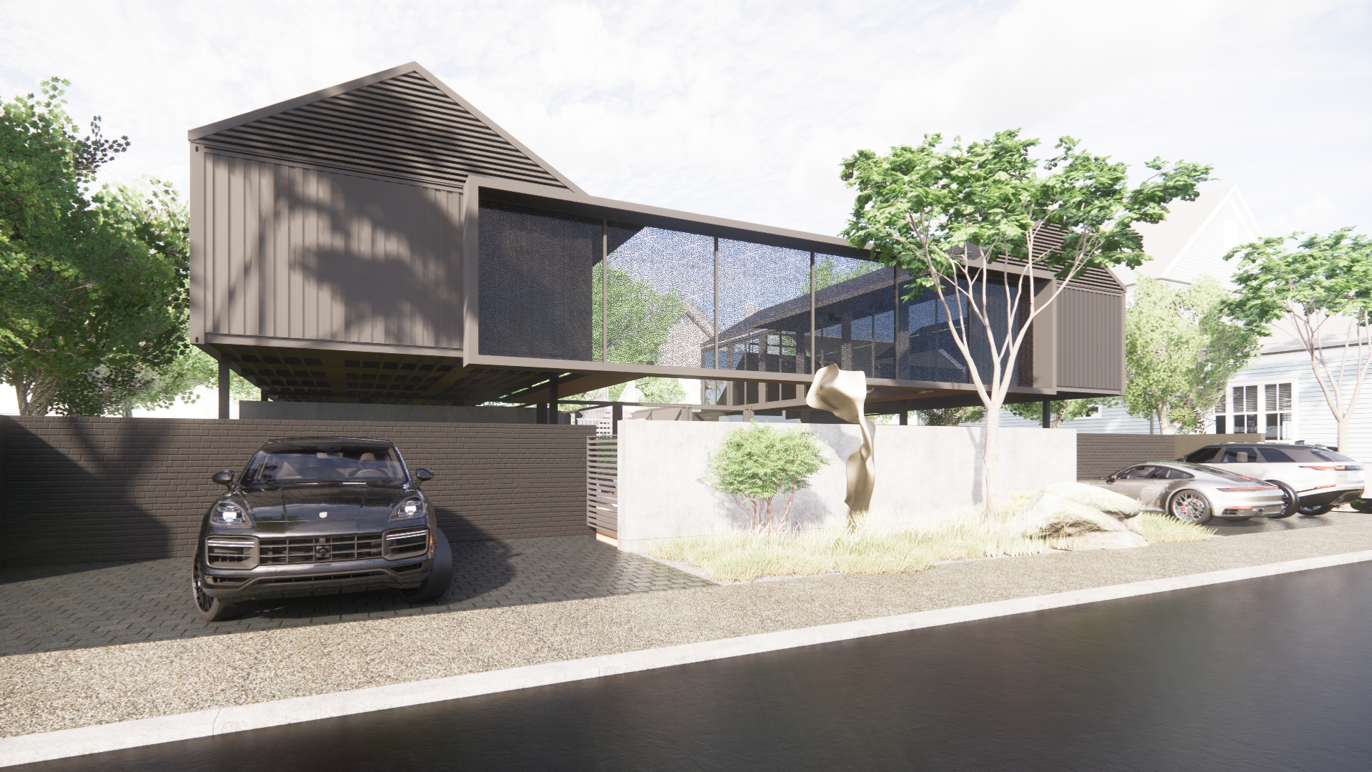

Slide 20
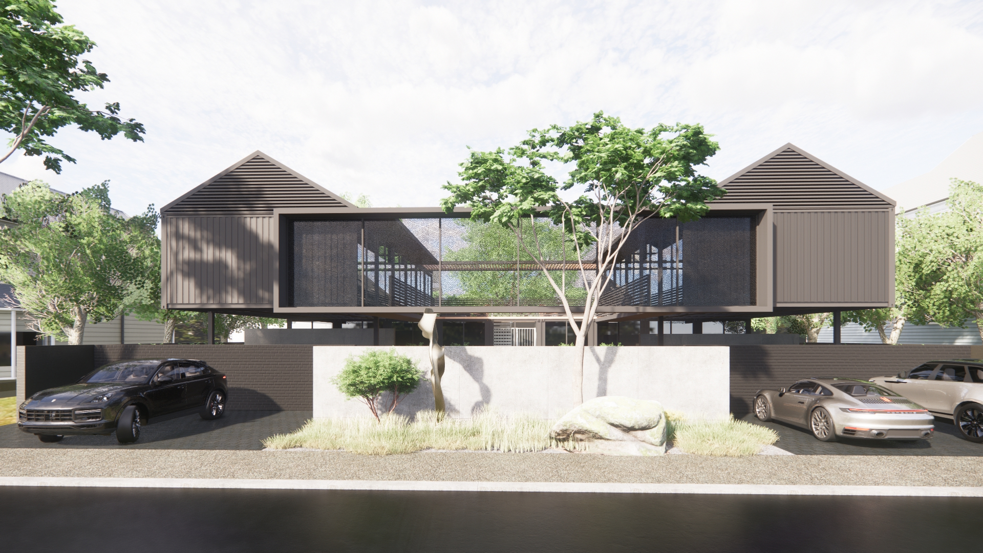

Slide 21
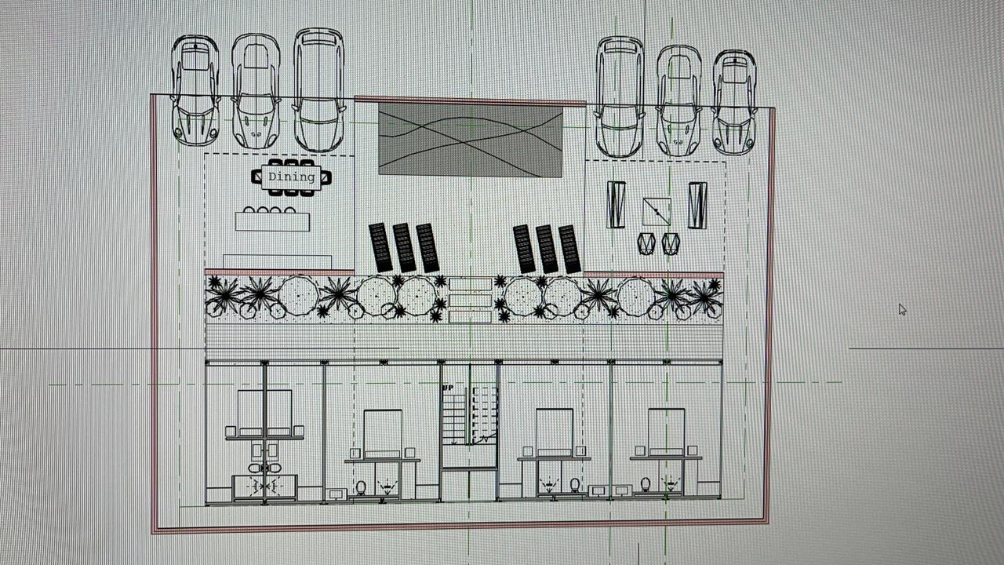

Slide 22
